Slide 1
Customer Relationship Management
Seshadri Rao Gudlavalleru Engineering College
Team Members
Yarroju Rudra Prakash
Lasya Galla
Anuhya Yaralagadda
Maddhali Rudra Sai Naga Venkata Sanjay Gupta

Slide 2
The application consists of the following main components:
Sidebar: For navigation
Dashboard: Overview of key metrics and activities
Inventory: Management of products and stock levels
Orders: Tracking and managing customer orders
Customers: Managing customer information and interactions

Slide 3
Project Setup
Prerequisites
• Node.js and npm installed
Create a New React Project
npx create-react-app react-crm
cd react-crm
npm start
Install Required Packages
npm install react-router-dom

Slide 4
Components
1. App Footer Component
2. App Header Component
3. App Routes Component
4. Page Content Component
5. Side Menu Component
6. App Component

Slide 5
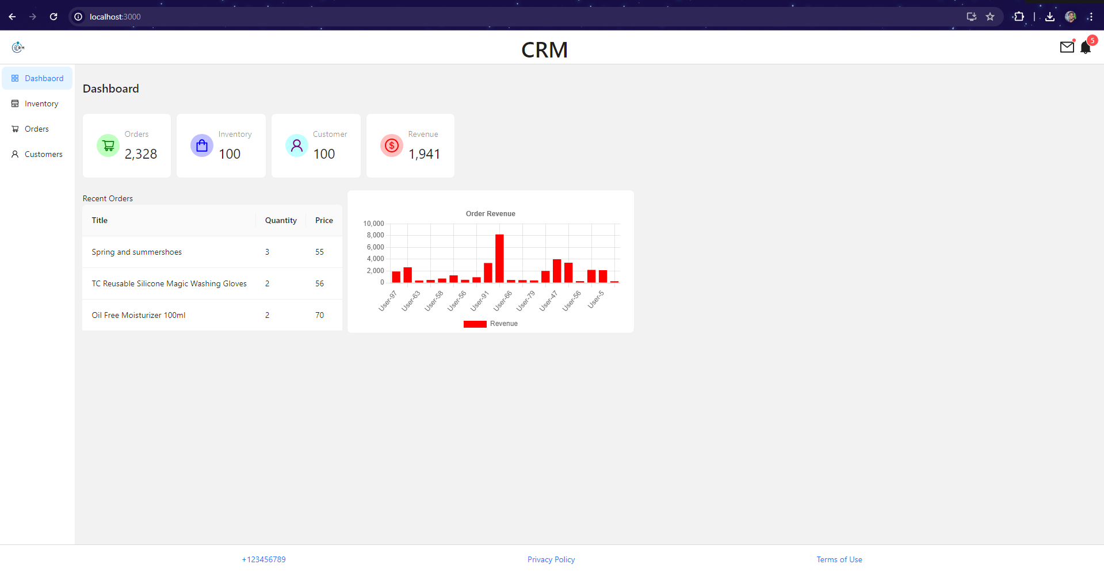
Results
Dashboard Component

Slide 6
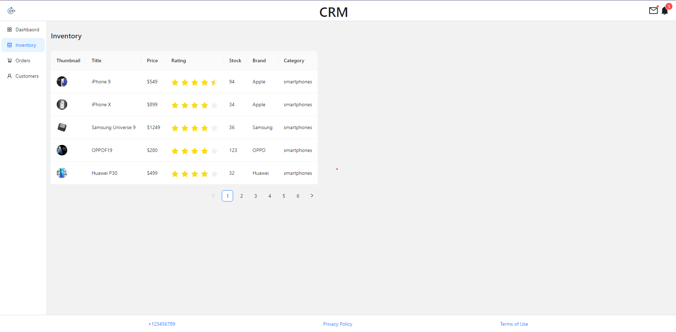
Inventory Component

Slide 7
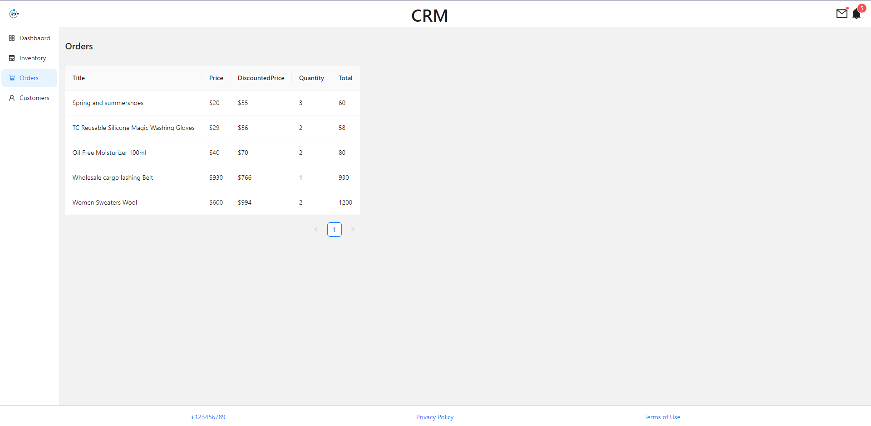
Order Component

Slide 8
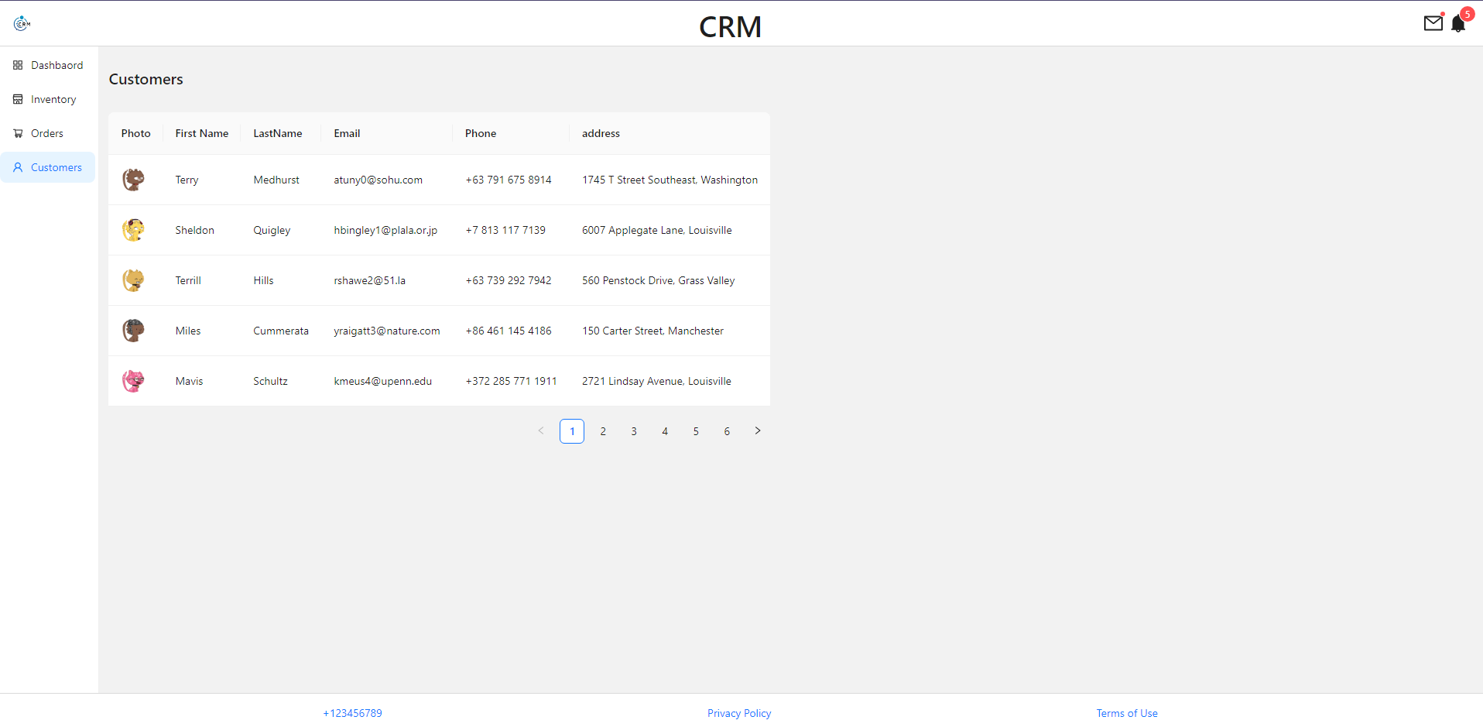
Customers Component

Slide 9
Conclusion
This projects provides a comprehensive guide to building a basic CRM system using React, covering project setup, component creation, routing configuration, and basic styling. You have established a modular architecture with key components: Sidebar, Dashboard, Inventory, Orders, and Customers, each tailored to specific functionalities. The Sidebar enables smooth navigation, the Dashboard offers an overview of key metrics, and the Inventory, Orders, and Customers components manage essential CRM data. Moving forward, you can enhance the CRM system by adding forms for data management, integrating state management solutions like Redux or Context API, and connecting to APIs for dynamic data fetching. This foundational setup equips you to build a scalable and feature-rich CRM application.

